Slide 1
Timetabling Improvements
Ben de Sousa, Alexandros Zachakos, Nolan Willoughby,
Todd House, and Conor McArthur

Slide 2





Time Goals
Reduction in core hours to 9am-5pm
Average room utilisation of 75% of timetable slots
1-hour Lunch break between 12-2pm
Minimisation of clashes
Notes:
Our team set out to try to answer questions from the “Time” related scenario group. We aimed to reduce teaching hours daily to 9-5. We set a goal of average room utilization of 75%, guaranteeing a 1 hour lunch break anytime between 12-2pm, and with the background/undercurrent motivator of minimizing clashes including optional courses across schools.

Slide 3
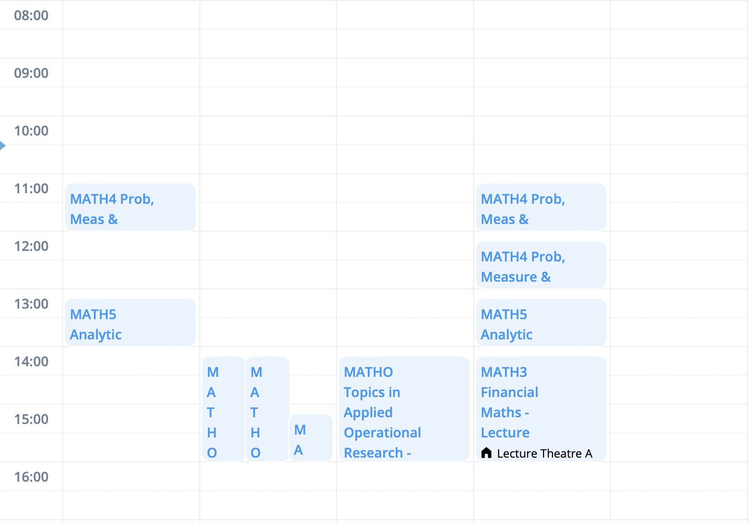
Motivation

Slide 4
Methods
Lit. Review & Data Processing
Model Formulation
Vet School
Multiple Schools
Improvements
Data challenges: formatting, redundant entries, conflicting details
MIP
Vet School tuning
Apply lessons learned to entire school set
Genetic Algorithm

Slide 5
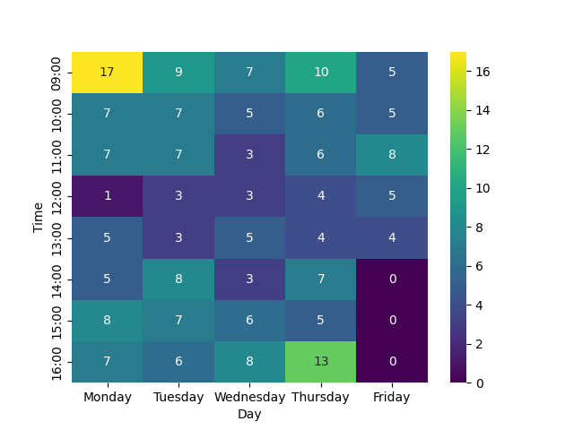
Vet School Results
Notes:
Violations of the daily end time are from the med school which requires too much time for certain courses.

Slide 6
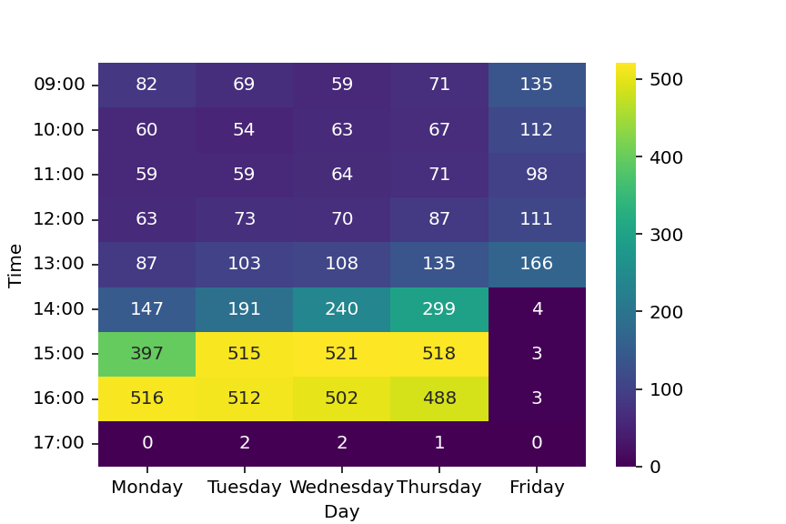
Baseline Results
Notes:
Violations of the daily end time are from the med school which requires too much time for certain courses.

Slide 7
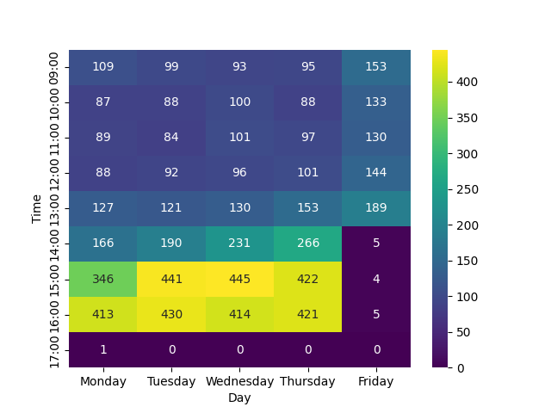
Improved Model Results

Slide 8
Metrics
Violations | Base | Improved
Clashes | 9,431 | 8,019
Lunch Break | 0 | 0
After 5pm | 5 | 1
> 6hr / day | 33,268 | 33,189
Friday Afternoons | 13 | 14

Slide 9
Considerations
Improve OR Efficacy
Suitability
Formulation
Constraints
Well suited to problem
Large problem space with high computational demands
Many relaxations required
Notes:
Suitability
Formulation?
Constraints

Slide 10
Data Restructuring
Recommendations
Refine data entry
Tiered deconfliction meetings
Tracked “sub” degrees
Push for fundamental changes in teaching format
Degree Options
Daily Layout

Slide 11
Thank You
Do you have any questions?

Slide 12
Example New Teaching Format
A
B
A
B
A
0900- Simulation
1100- TOR
1500- Credit Scoring
1000- Risk and Logistics
1200- OREI
1600- SRS
0900- Simulation
1100- TOR
1500- Credit Scoring
1000- Risk and Logistics
1200- OREI
1600- SRS
0900- Simulation
1100- TOR
1500- Credit Scoring

